Slide 1
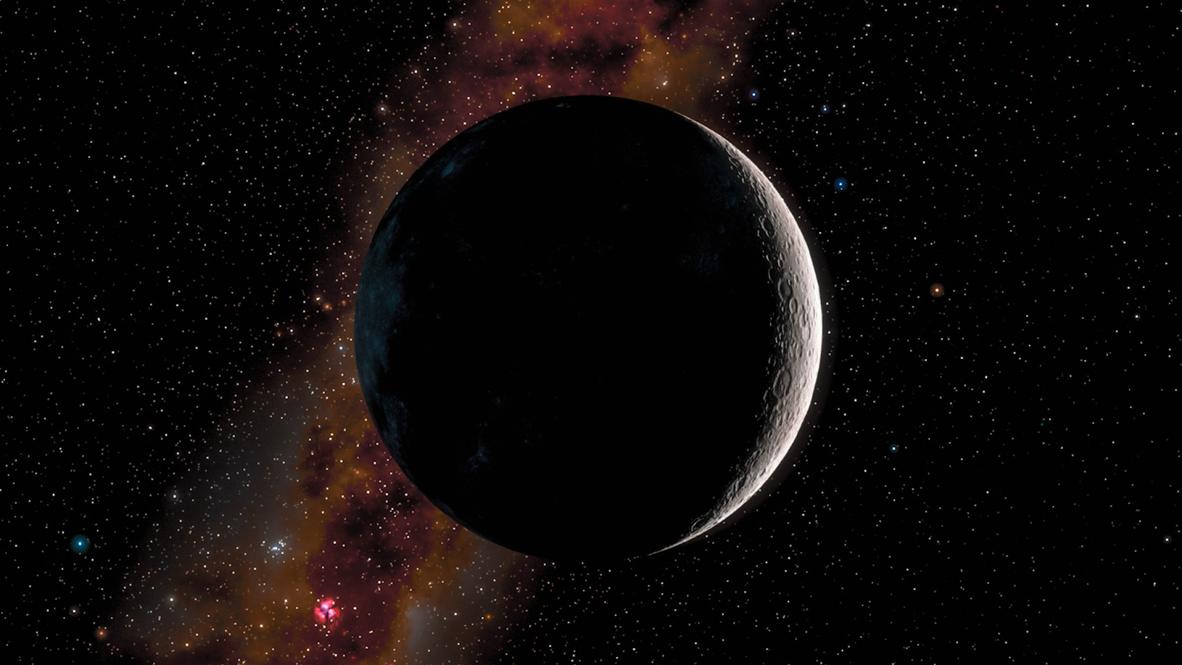

Lunar Internet of Things
Jarod Lopez, Emily Claros, Julie Castro Pena, Samhith Marni, Lekh Patel

Slide 2



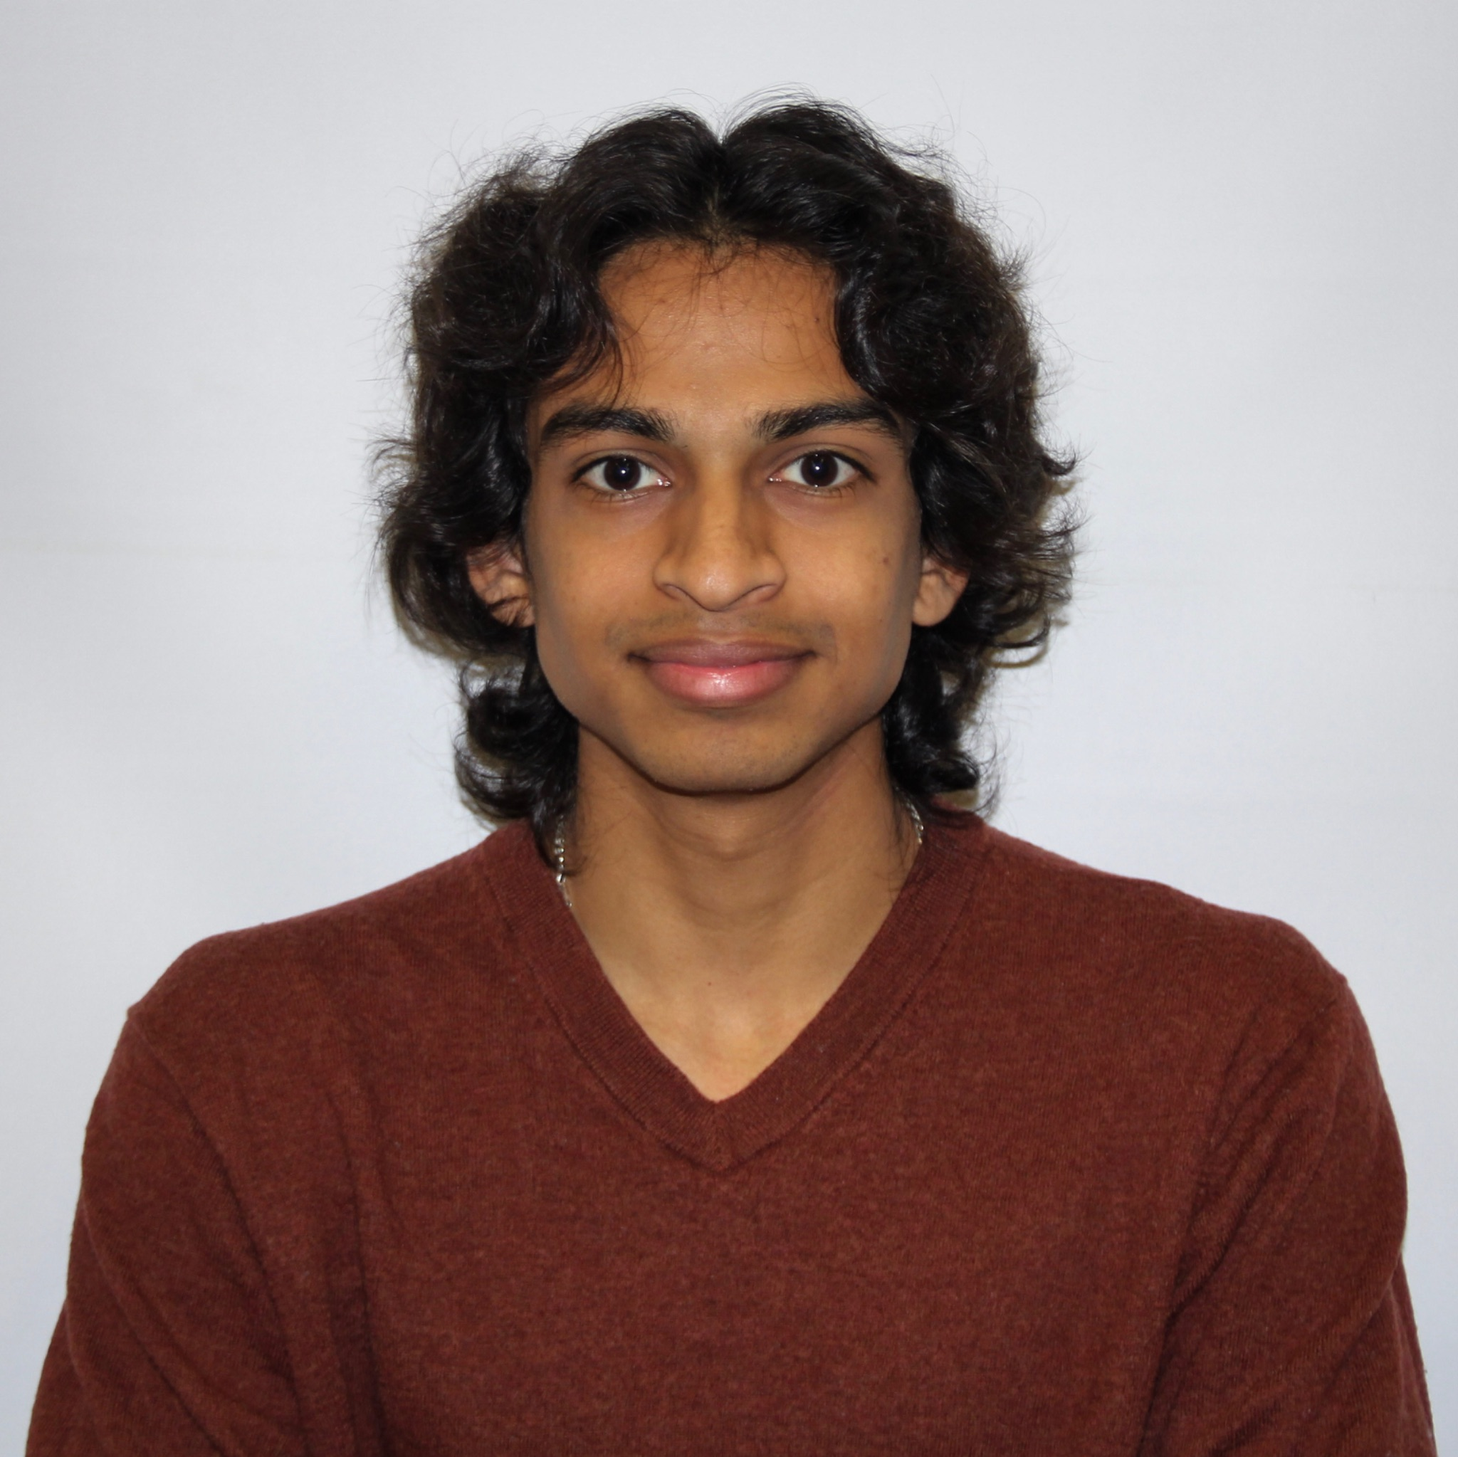
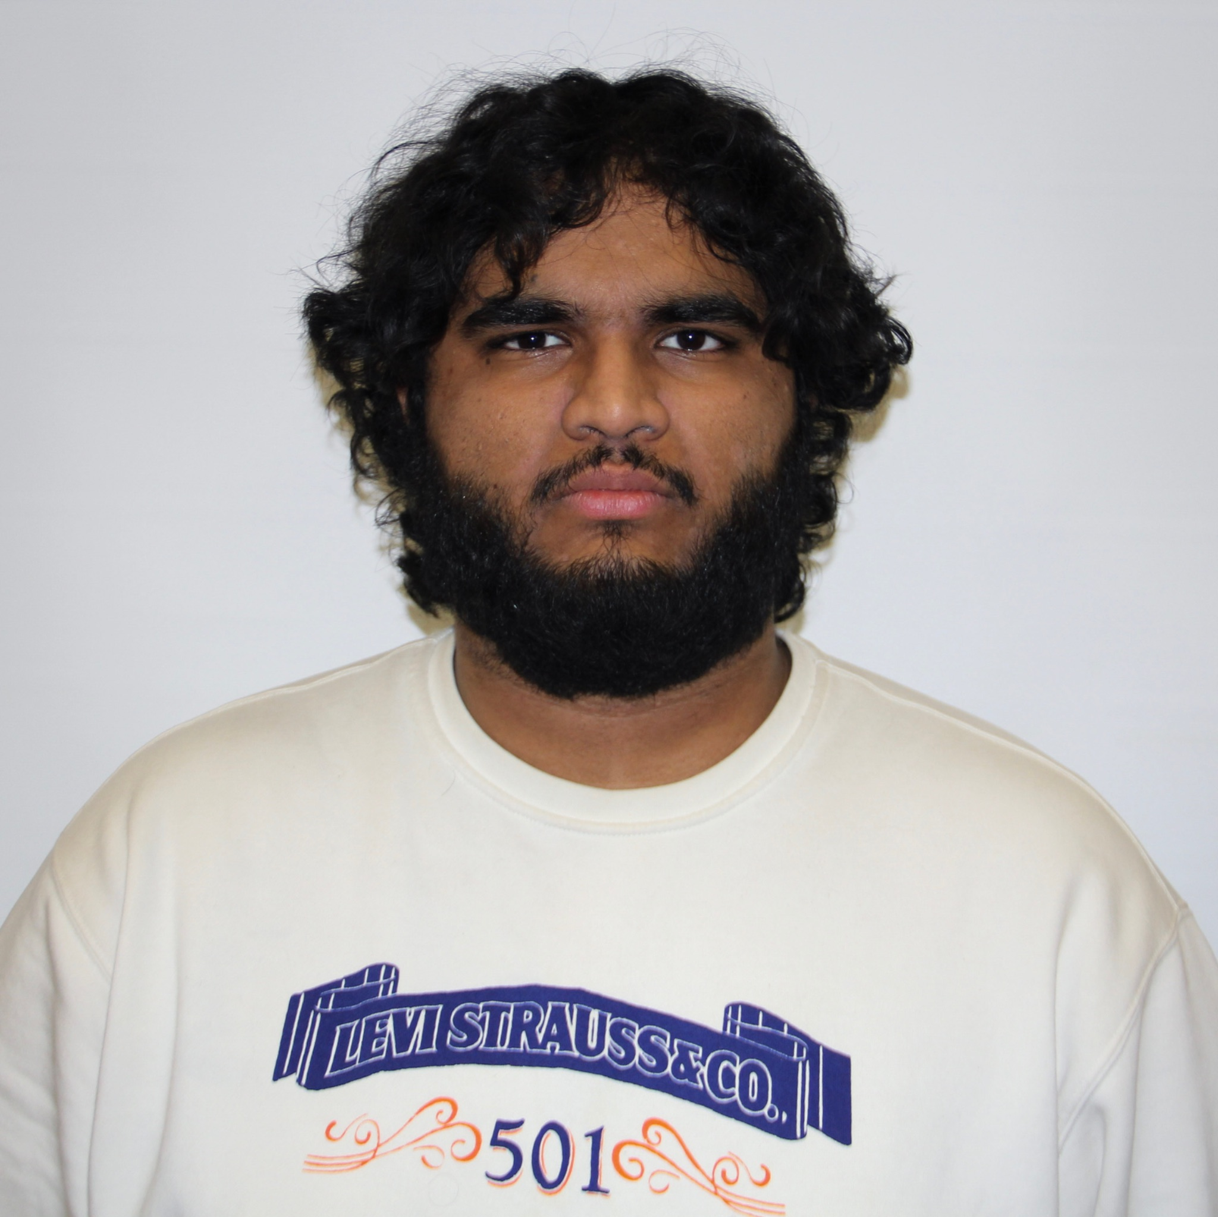

Meet The Team
Emily Claros
Jarod Lopez
Lekh Patel
Project Manager
Project Manager
Associate Manager
Samhith Marni
Julie Castro
Team Member
Team Member

Slide 3
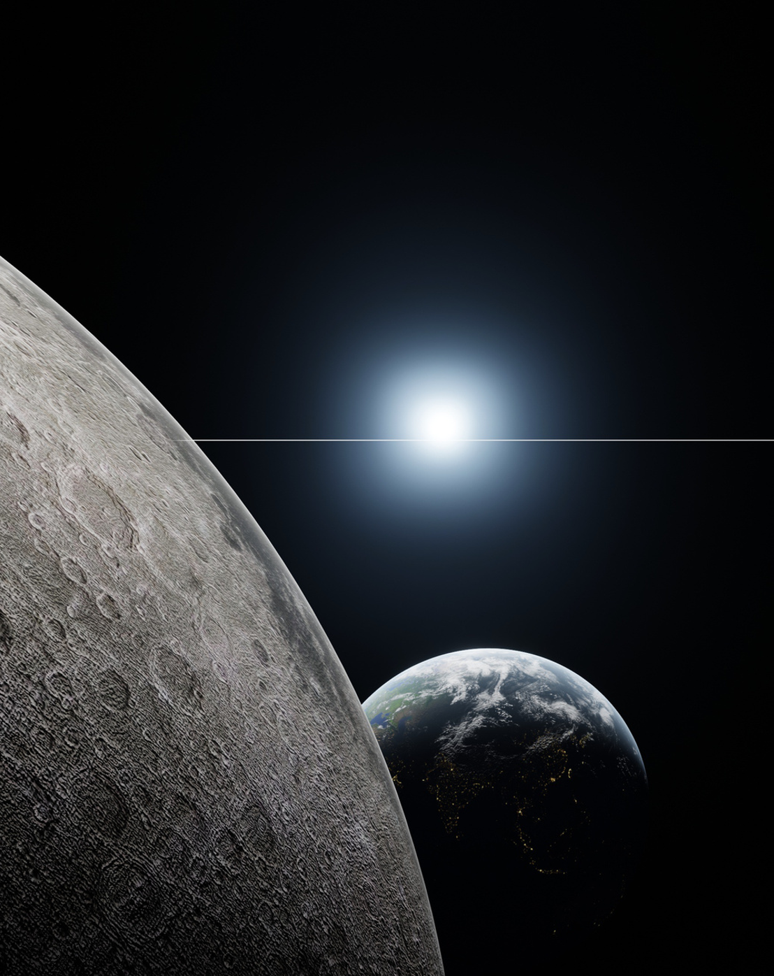
01
OVERVIEW

Slide 4

Project Overview
Goal: Build an Internet of Things (IoT) system for the lunar surface in collaboration with students from Rowan University and members of NASA’s Stennis Space Center.
Autonomous operations of lunar devices, enabling a rover to traverse the lunar surface in an efficient manner.
Establish communications between devices over an MQTT broker, allowing for the reception and analysis of data (i.e. battery station power levels).
Real time data processing to enable decision making, allowing rover to determine the most optimal path between objectives and battery stations.
Notes:
Emily

Slide 5
Project Overview
WHY?: As NASA makes advancements in establishing a sustained human and robotic presence on the Moon, there is a growing need for:
Reliable communications among assets on the lunar surface.
Autonomous decision making to reduce the impact of communication delays between the Earth and lunar surface.
Efficient power management for extended missions in extreme lunar environments.
Data systems to handle reception and sending of information for analysis.
Compliments NASA’s LuCCI project
Successful implementation of the IoT system provides for:
Communication amongst devices, enabling autonomous systems to operate in a more efficient and cooperative manner
Minimal human interaction in the operation of assets on the lunar surface
Notes:
Jarod

Slide 6
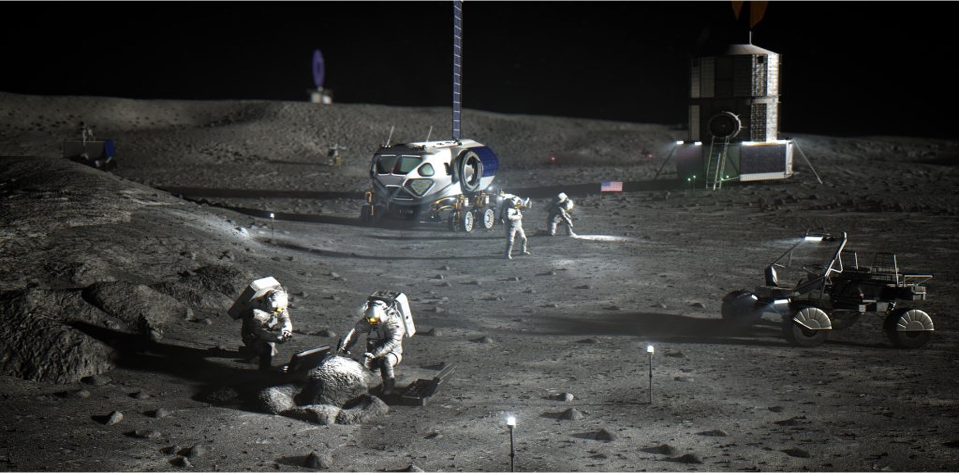
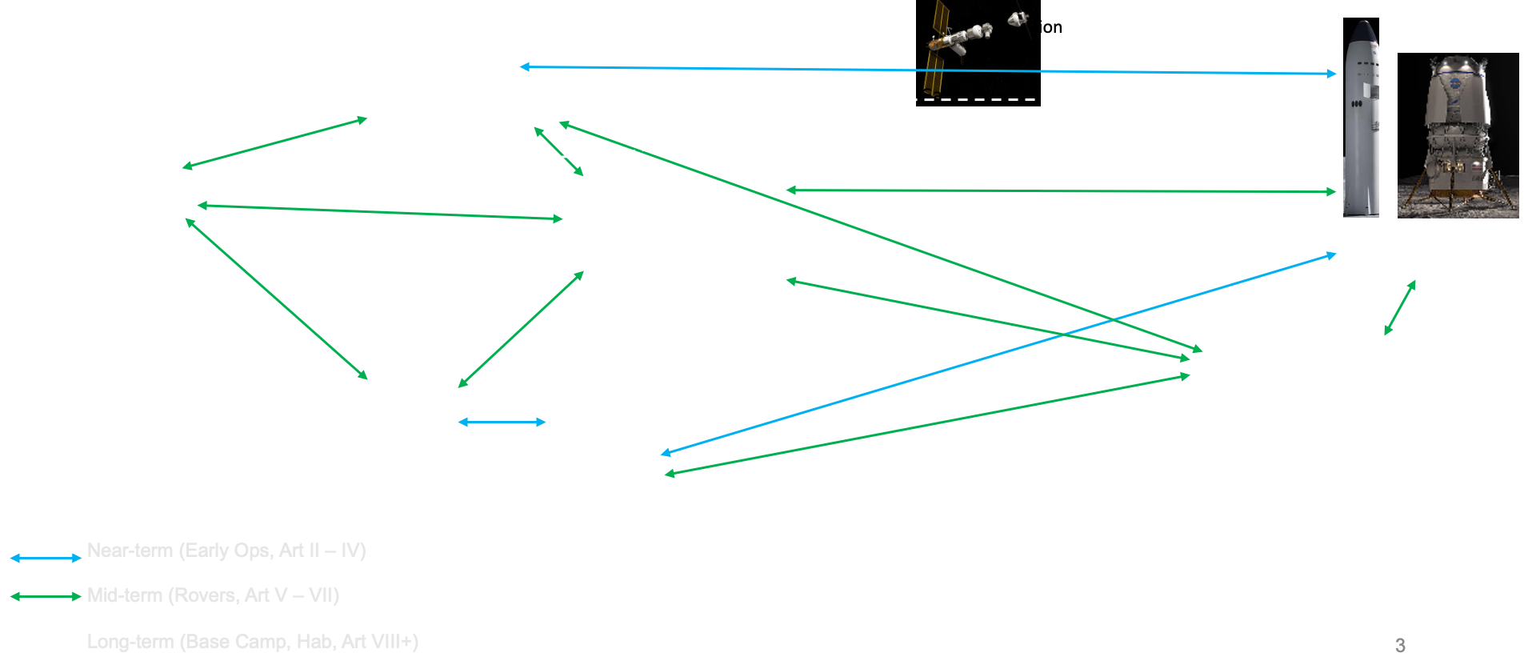
LUCCI - Lunar Command and Control Interoperability
The LUCCI project was developed to address how Lunar Surface Systems (LSS) would work together across multiple programs and with different commercial & international partners.
The objective is to design and integrate an interoperable lunar command, control, data, and software architecture to enable autonomy and informatics capability through common standards across LSS.
NASA - LuCCI
Notes:
Lekh

Slide 7
Wi-Fi HaLow Overview
What Is Wi-Fi Halow?:
Low-power, long-range Wi-Fi standard based on IEEE 802.11ah
Operates in the sub-GHz spectrum (~915 MHz) which is ideal for IoT and remote sensing
Extended range and strong signal penetration through obstructions
Secure and scalable connectivity with WPA3 encryption support
Trade-off: lower bitrate (~32 Mb/s) compared to >1 Gb/s for Wi-Fi 6 (802.11ax)
Enables IoT-based communication between the rover and base station
Notes:
Lekh

Slide 8

PyBaMM and Teds
What Is It?:
PyBaMM stands for Python Battery Mathematical Modeling
It’s an open-source framework that simulates battery behavior using physics-based models
Built on electrochemical principles not just simple voltage vs. charge lookups
Why It Matters?:
Simulates real-time State of Charge (SoC), voltage, temperature, and health (SoH)
Predicts energy usage for different terrain types, slopes, and speeds
Helps plan feasible missions — ensuring the rover doesn’t die mid-route
Provides accurate charging profiles when connecting to stations
Enables energy-aware path planning (A* uses PyBaMM data to pick energy efficient routes)
Notes:
Samhith

Slide 9
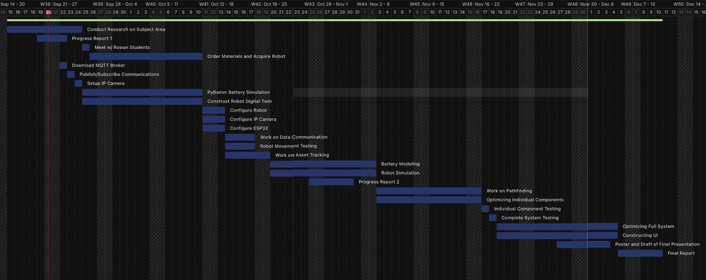
Gantt Chart
Notes:
Julie

Slide 10
02
ROVER

Slide 11
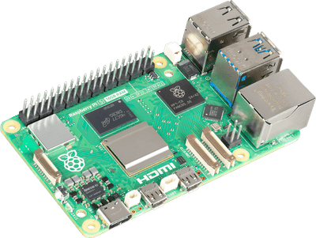

Materials
HARDWARE:
SOFTWARE:
Raspberry pi
MicroROS rover
Power banks
Memory cards
LEDs, resistors, jumper wires
Servo motors
ESP32 development board
Cameras
ROS 2
Unreal Engine
Unity
Autodesk Fusion360
Cesium
OpenCV
MQTT Servers/Brokers
Blender
Notes:
Julie

Slide 12
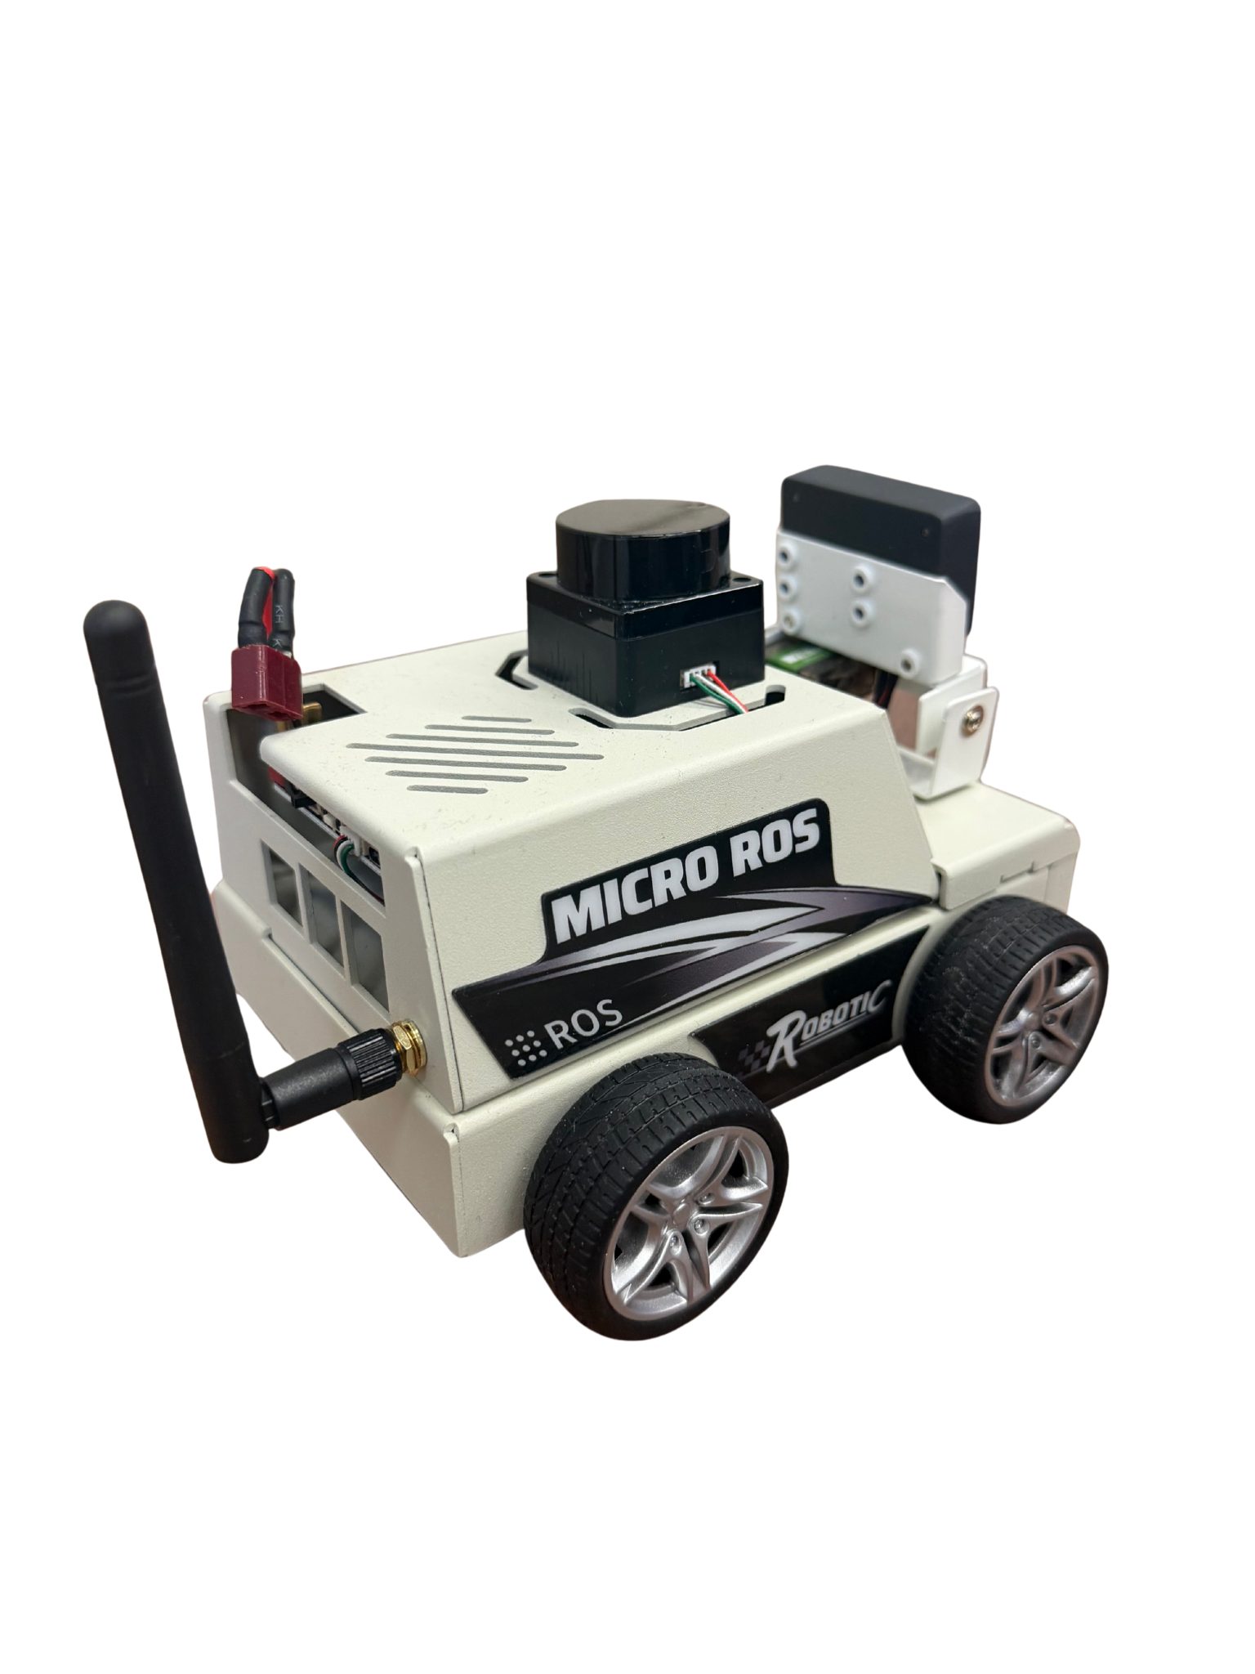
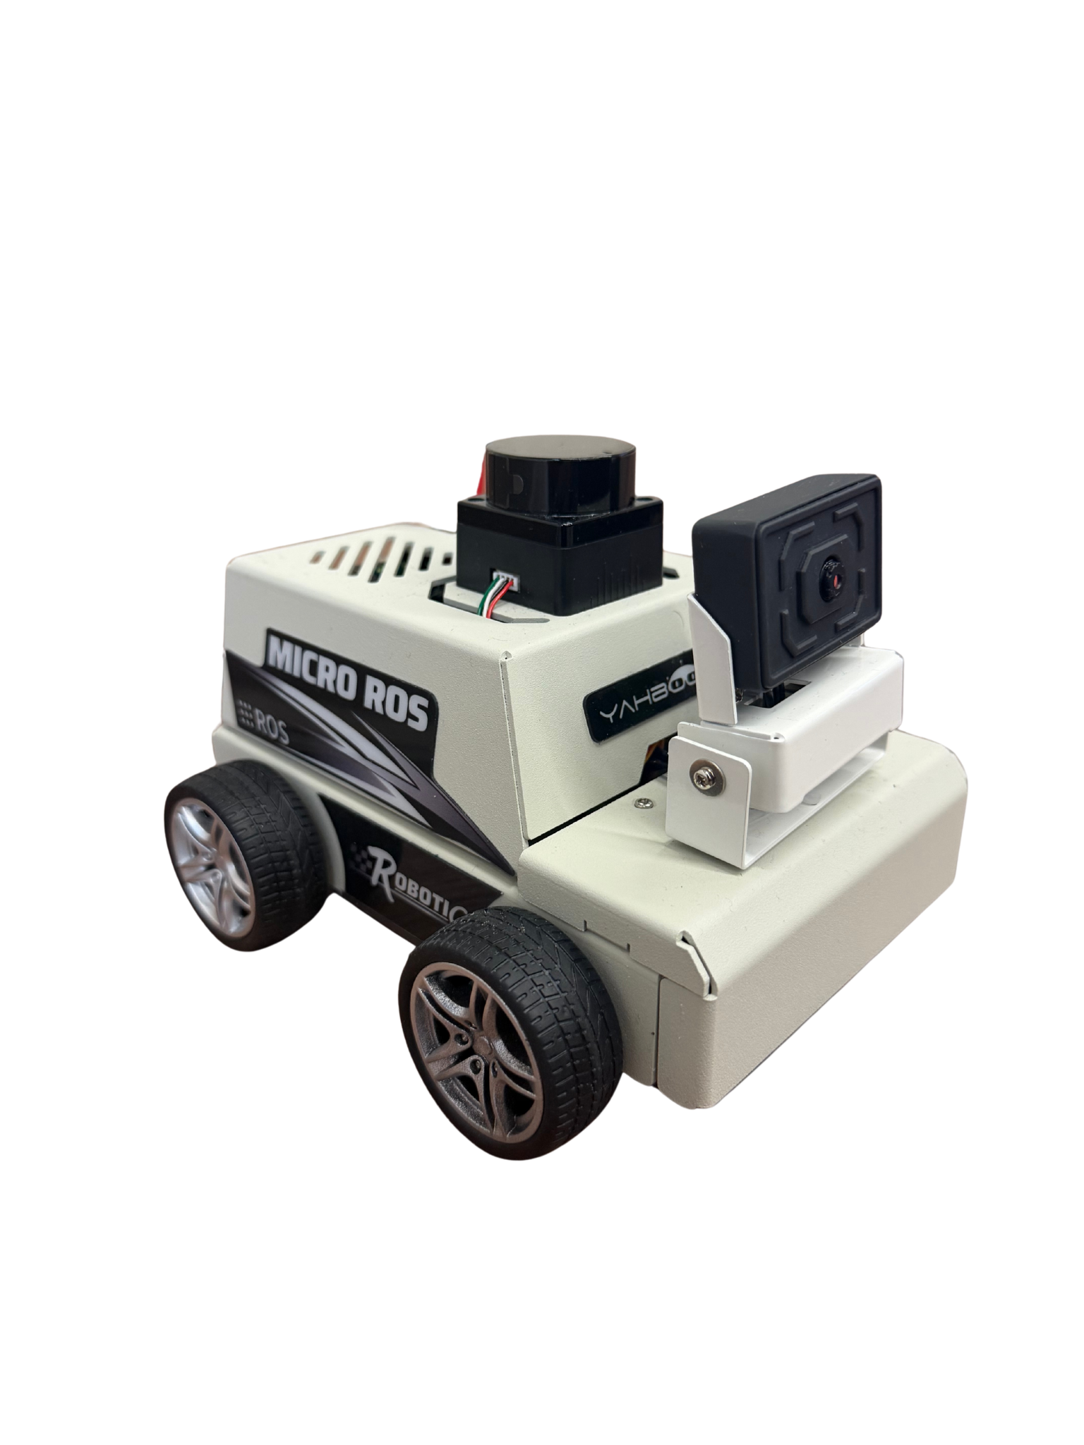
Lunar Rover
WHAT IS IT?
The rover is a mobile unit designed to demonstrate autonomous decision-making on the lunar surface.
It navigates between objectives and charging stations using onboard sensors, ROS 2 communication, and micro-ROS firmware.
The system integrates both physical and simulated components for testing and data analysis.
WHY IT MATTERS:
Enables autonomous movement and coordination between lunar assets.
Demonstrates efficient power management through simulated energy models.
Serves as the foundation for testing communication, navigation, and digital twin integration.
Notes:
Julie

Slide 13
03
MODELING & PROGRAMMING

Slide 14
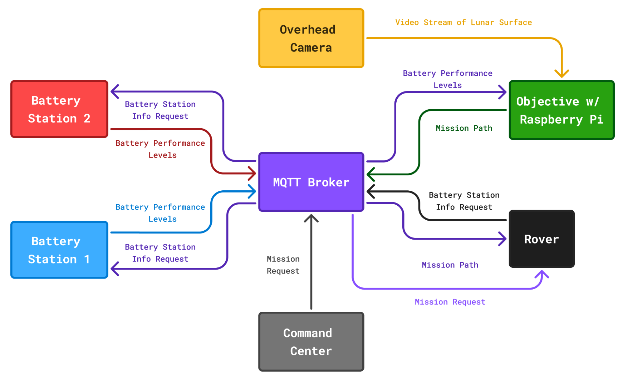
MQTT Broker Communication
Notes:
Jarod

Slide 15
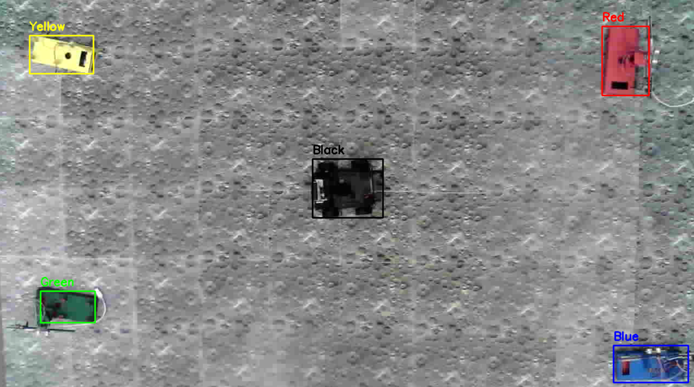
Computer Vision
The initial solution we considered was using a TinyML identification model from Edge Impulse, however, after training, we received accuracy scores around 50%.
Battery stations, objectives, and rovers were all painted/covered in colored construction paper to make for easier identification in computer vision
Created color detection function using OpenCV Python library
Used masks to isolate pixels that fall between specific HSV ranges
Colors identified: red, blue, yellow, green, and black
The coordinates of the bounding boxes were sent to the MQTT broker for the rover to use in pathfinding
Notes:
Jarod

Slide 16
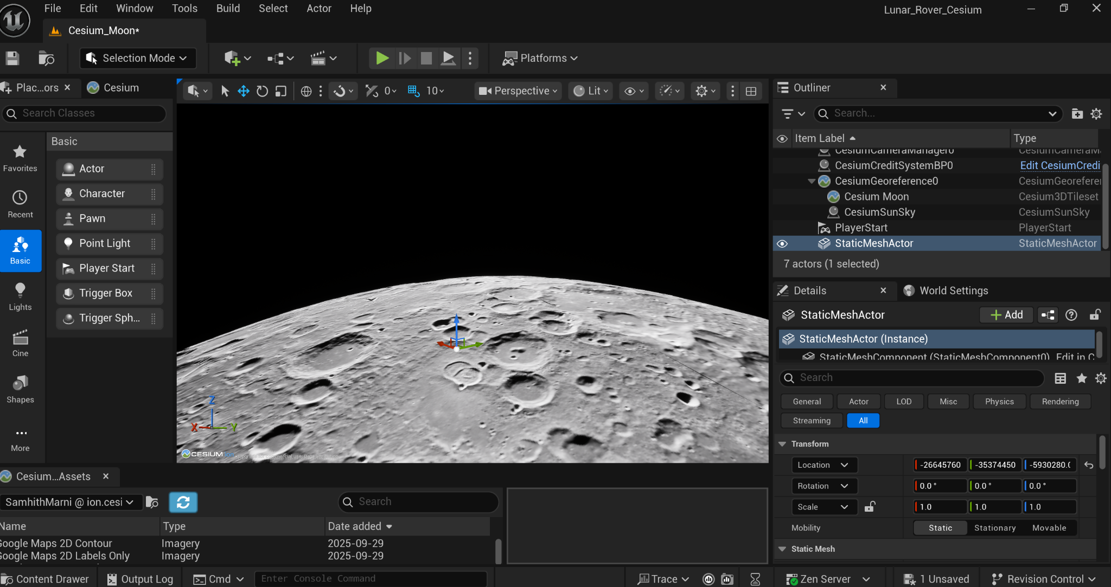
Digital Twin Rover Simulation
Unity Progress:
Started digital twin in Unity using Cesium’s lunar terrain.
Imported two rover models:
Yahboom rover model
NASA Curiosity Rover
Issues in Unity:
Wheel colliders constantly breaking
Rigidbody & terrain detection errors
Rover couldn't tell when it was on the ground
Movement scripts failing despite debugging
Decision: Transition to Unreal Engine for more stable, faster, and more efficient development.
Notes:
Emily/Samhith

Slide 17
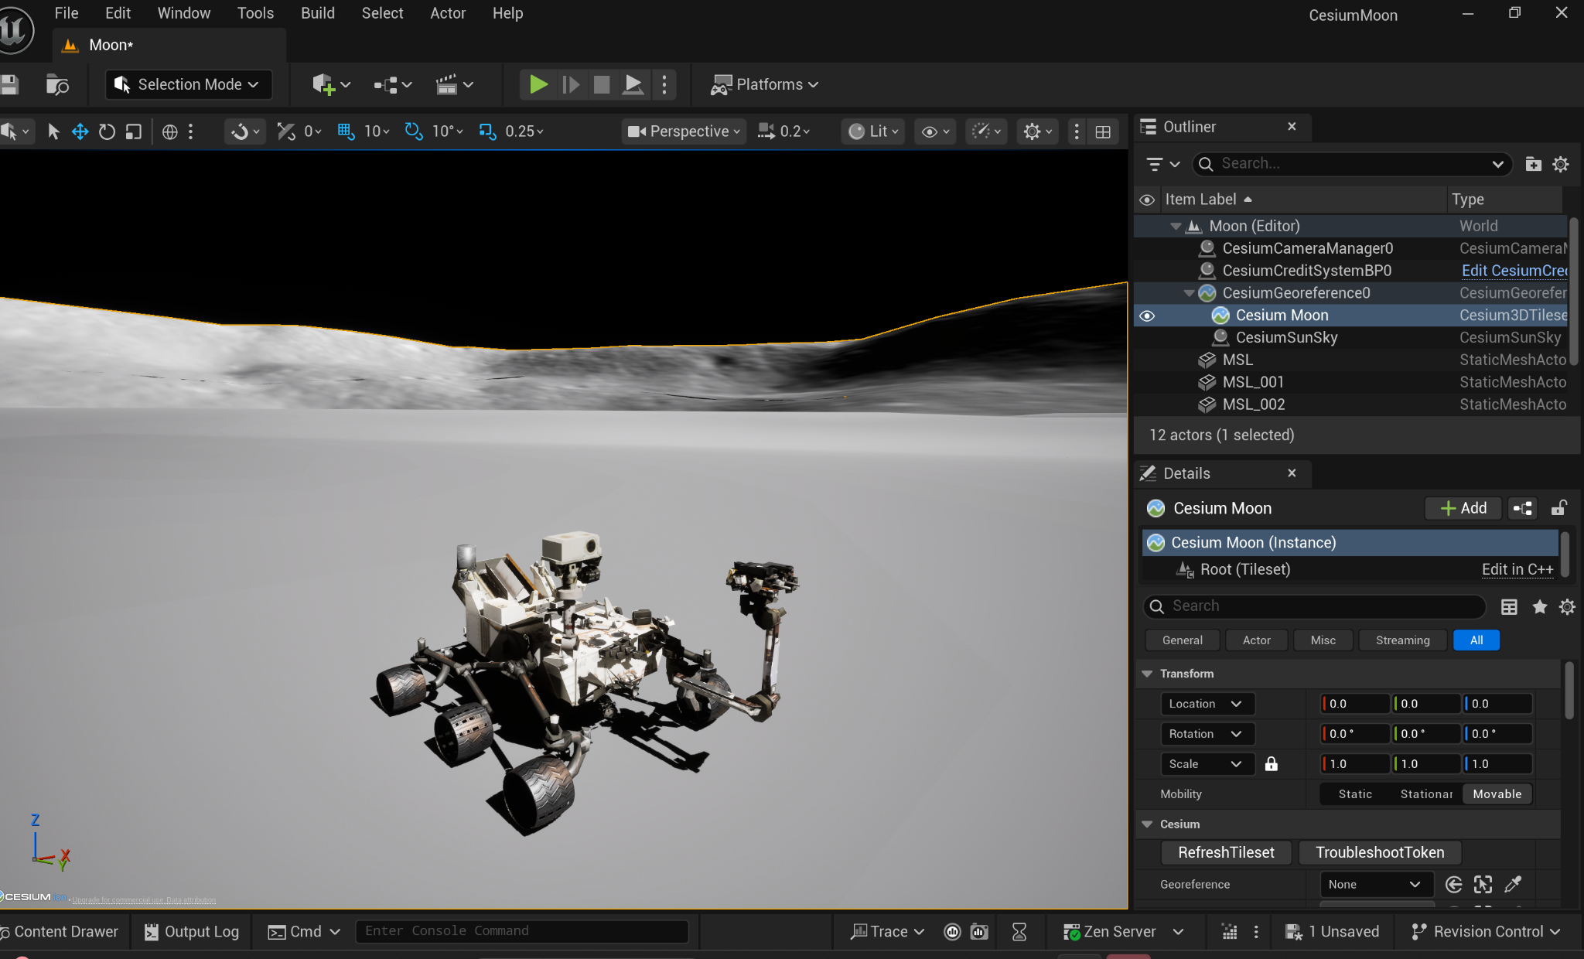
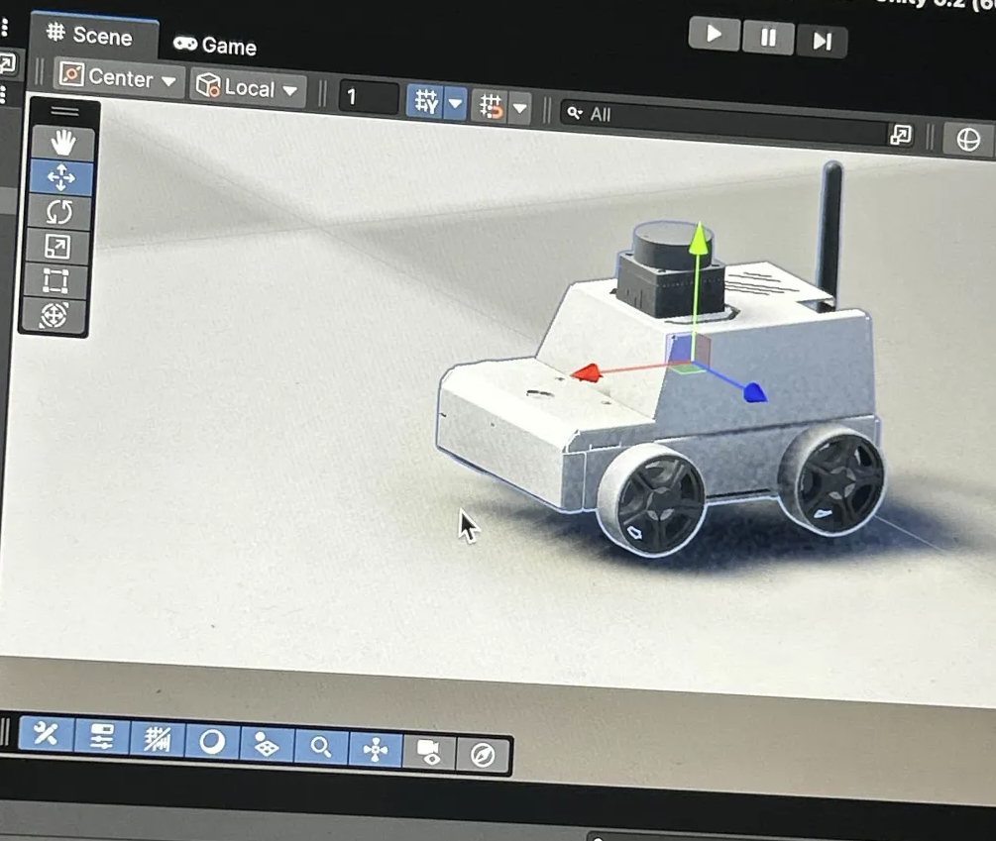
Digital Twin Rover Simulation Contd.
Notes:
Emily

Slide 18
Final Rover Simulation Implementation
Why Unreal Engine?
Better integration with Cesium for lunar terrain performance
Blueprint event graphs simplified rover control logic
Better support for wheels physics compared to Unity wheel colliders
Supports integration with MQTT for real rover communication
Unreal Engine Progress:
Imported a simple rover blueprint into the environment
Integrated directly into our Cesium lunar environment
Used event graphs to code movement and actions for the rover.
Used MQTT broker to send real life info to unreal engine
Remapped the rover and objective/charging stations onto ureal to scale.
Notes:
Samhith

Slide 19
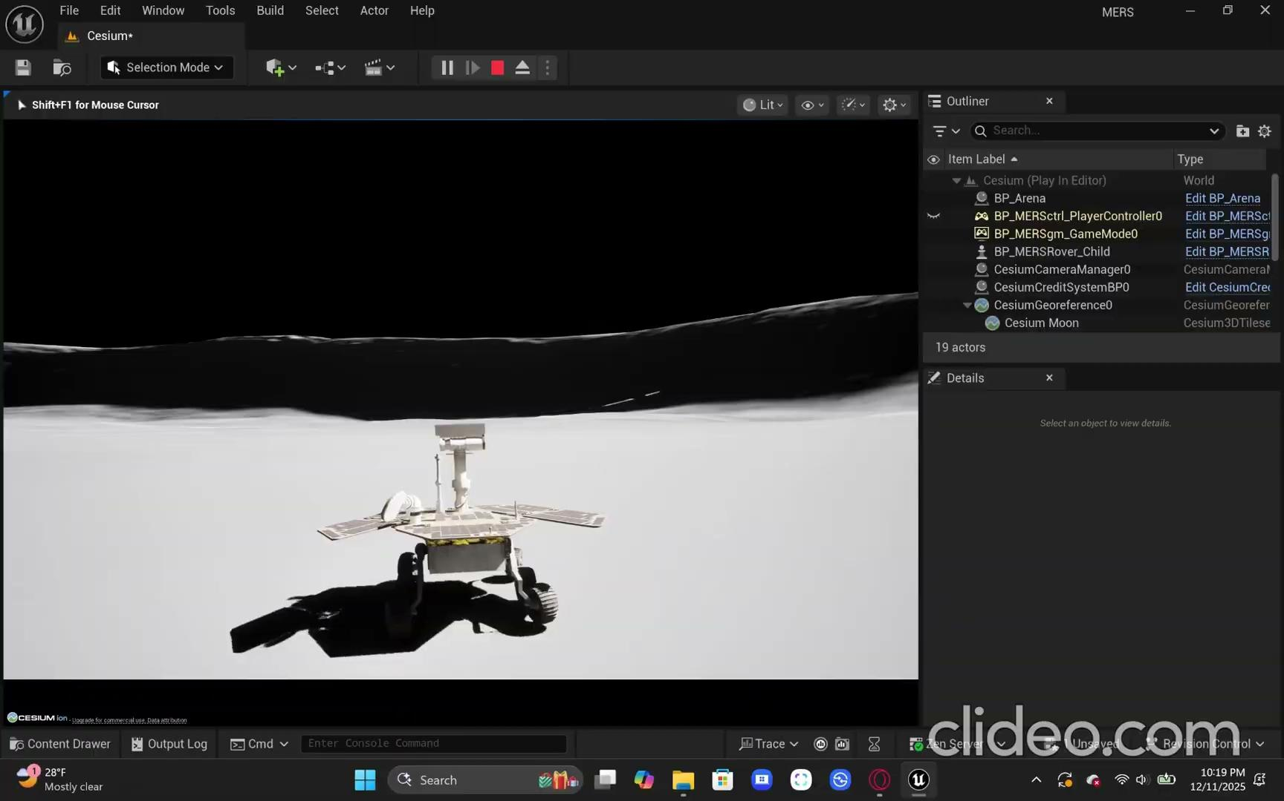
Digital Twin Demonstration
Notes:
Samhith

Slide 20
Component Testing & Integration
Individual components were tested as they were developed:
i.e. Color detection was tested extensively in isolation to make sure color ranges were correct in picking up objects before integrating into MQTT.
One of the final steps of the project was to combine the individual project parts together.
This included making sure the pathfinding algorithm was correctly receiving coordinates for objective/battery bounding boxes, Unreal Engine was correctly receiving coordinates to simulate the physical demonstration in the virtual lunar environment, etc.
A full system test was conducted after complete integration.
Notes:
Lekh

Slide 21

Rover Demonstration

Slide 22
Future Work
Integrating Dreamscape:
Future teams can explore linking the Digital Twin to Rowan University’s Dreamscape Learning Center to create a VR-based immersive environment.
Dreamscape Allows Users To:
Interact with the rover in a fully immersive VR simulation
Visualize lunar terrain and rover movement in real-time
Dreamscape Would Require:
Testing compatibility with Dreamscape hardware and software
Collaborating with Rowan’s Dreamscape team for system access and support
Notes:
Emily

Slide 23
Future Work
User Interface (UI) Development:
Our current system does not include a UI, future students can design one to make rover control and data visualization more accessible.
UI Could Include:
On-screen controls for rover movement
Live sensor readings (battery, velocity, etc.)
A map or minimap displaying rover position
Switching between different camera views
Implementing a UI would improve usability and support more advanced demonstrations.
Notes:
Jarod

Slide 24
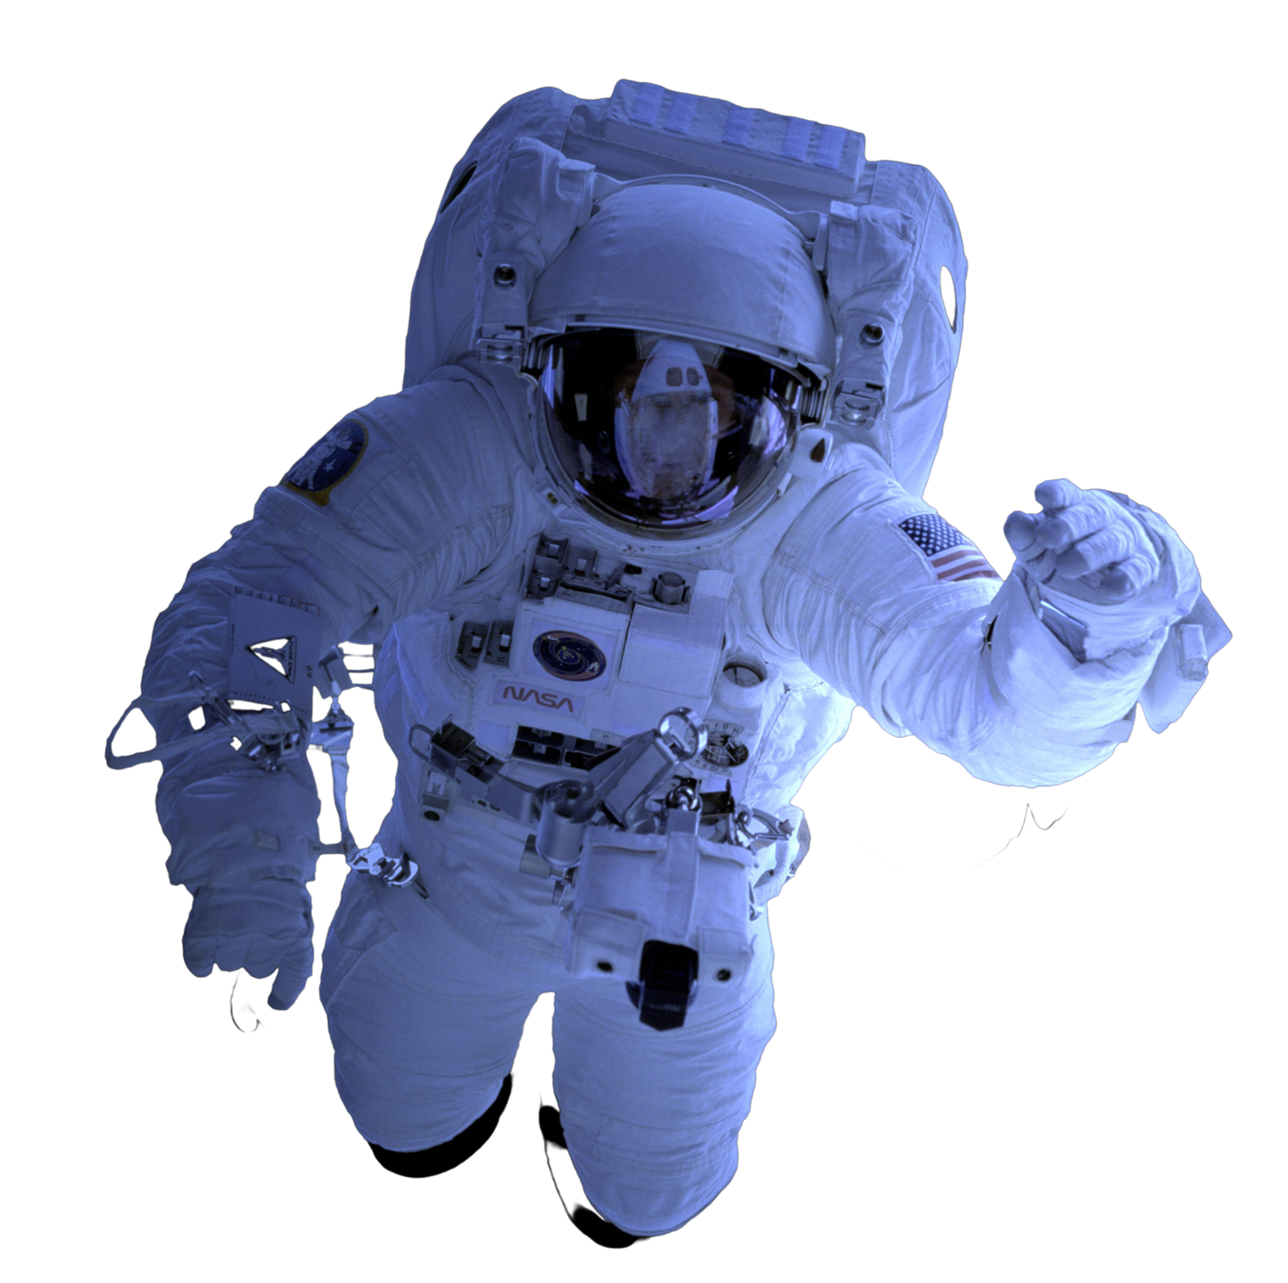
References
IBM. “What is the Internet of Things (IoT)?” IBM, 16 Sept. 2025, www.ibm.com/think/
topics/internet-of-things
O’Hagan, Brian. “Lunar Command and Control Interoperability (LuCCI) Project Overview” Johnson Space Center, 13 Oct. 2025, https://ntrs.nasa.gov/citations/20240003016

Slide 25
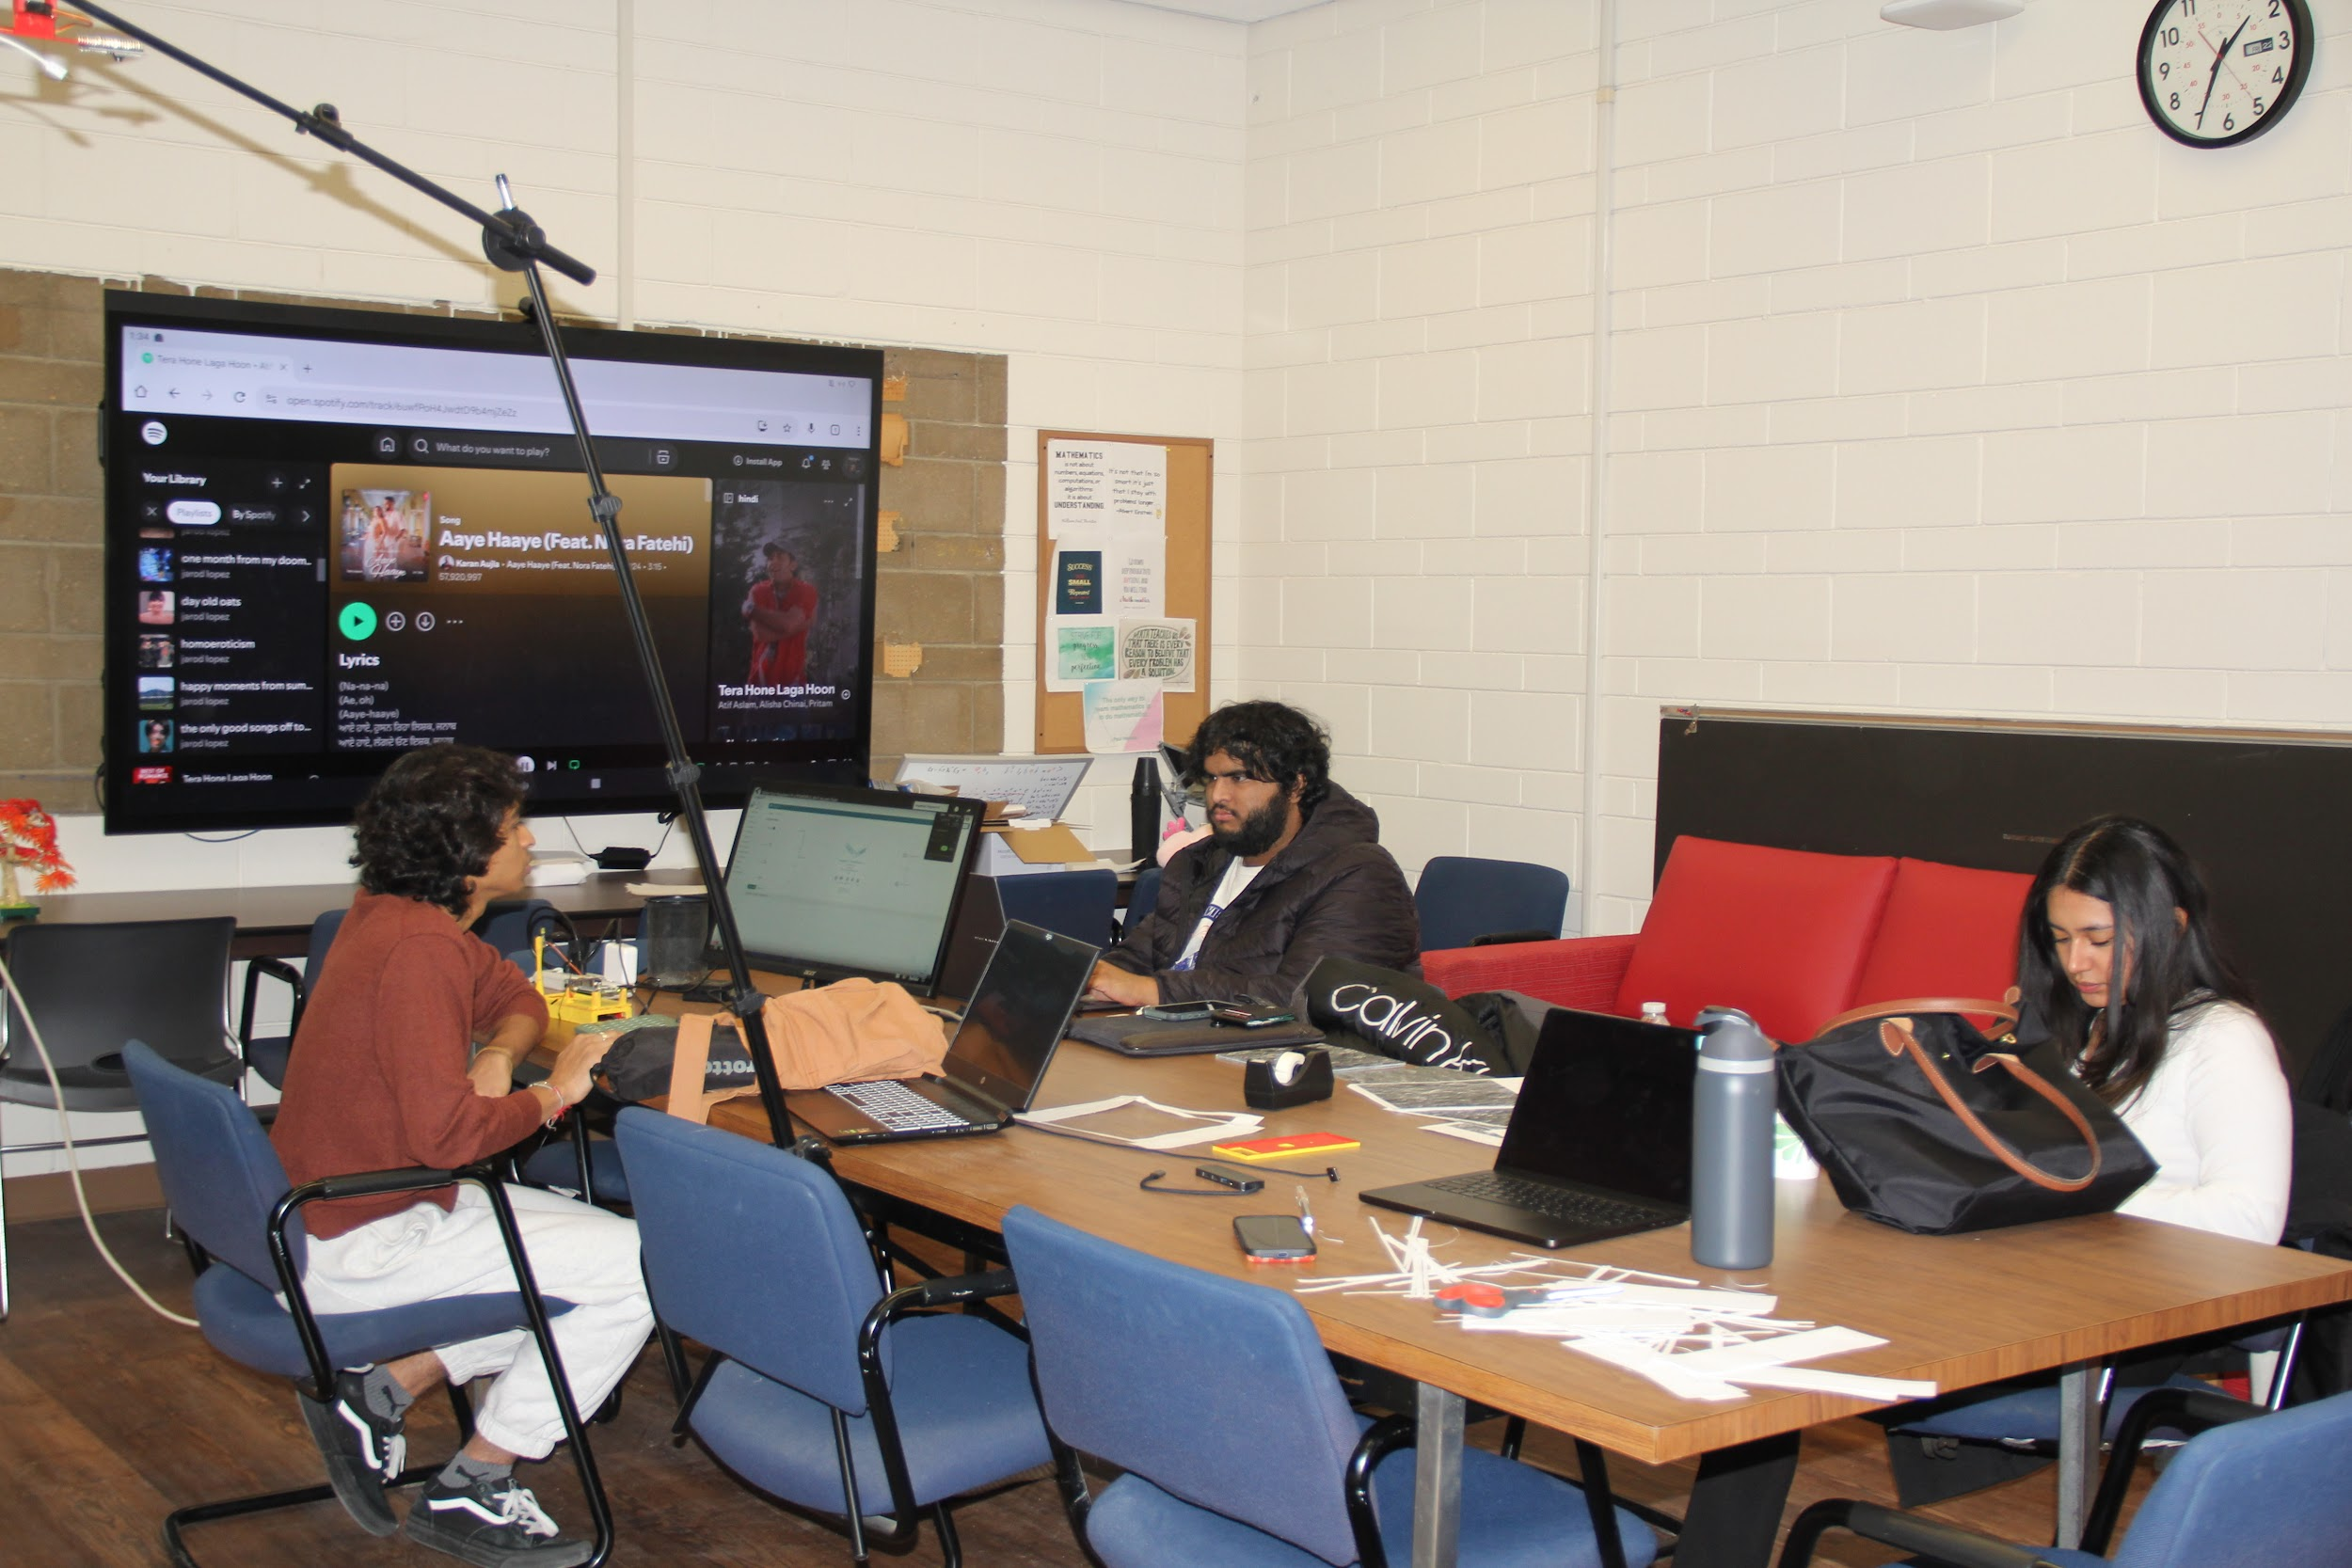
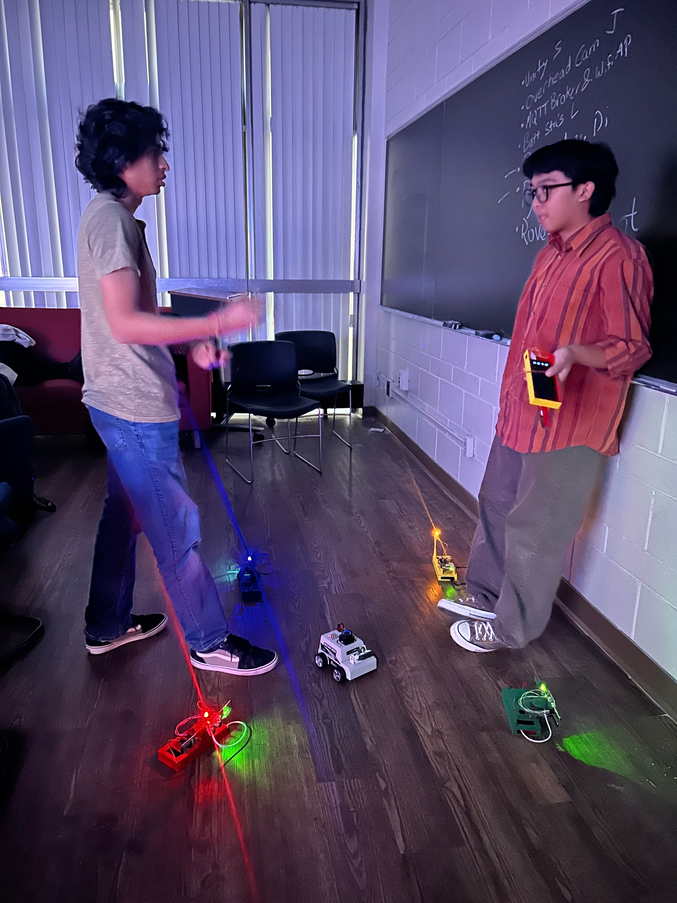
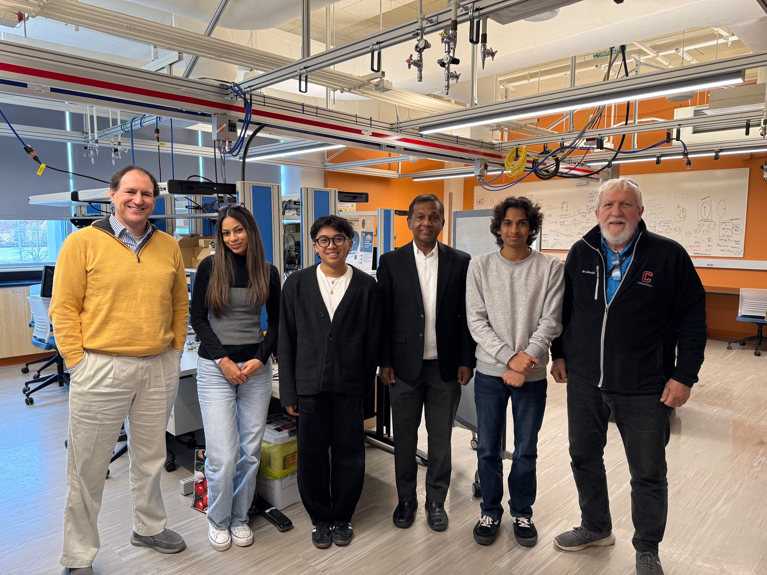
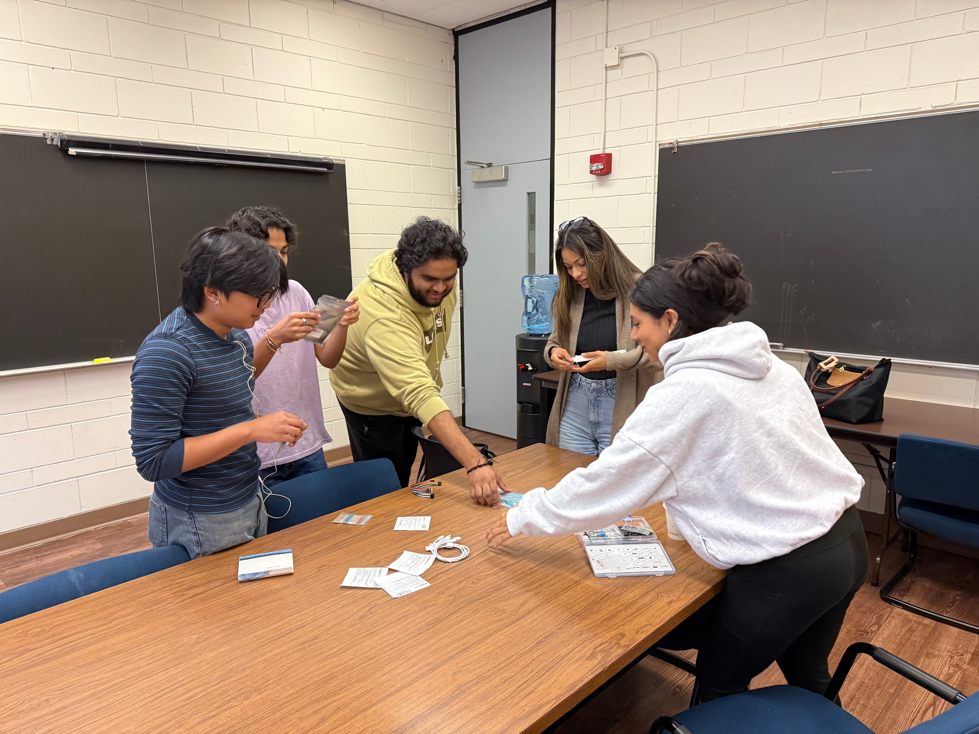
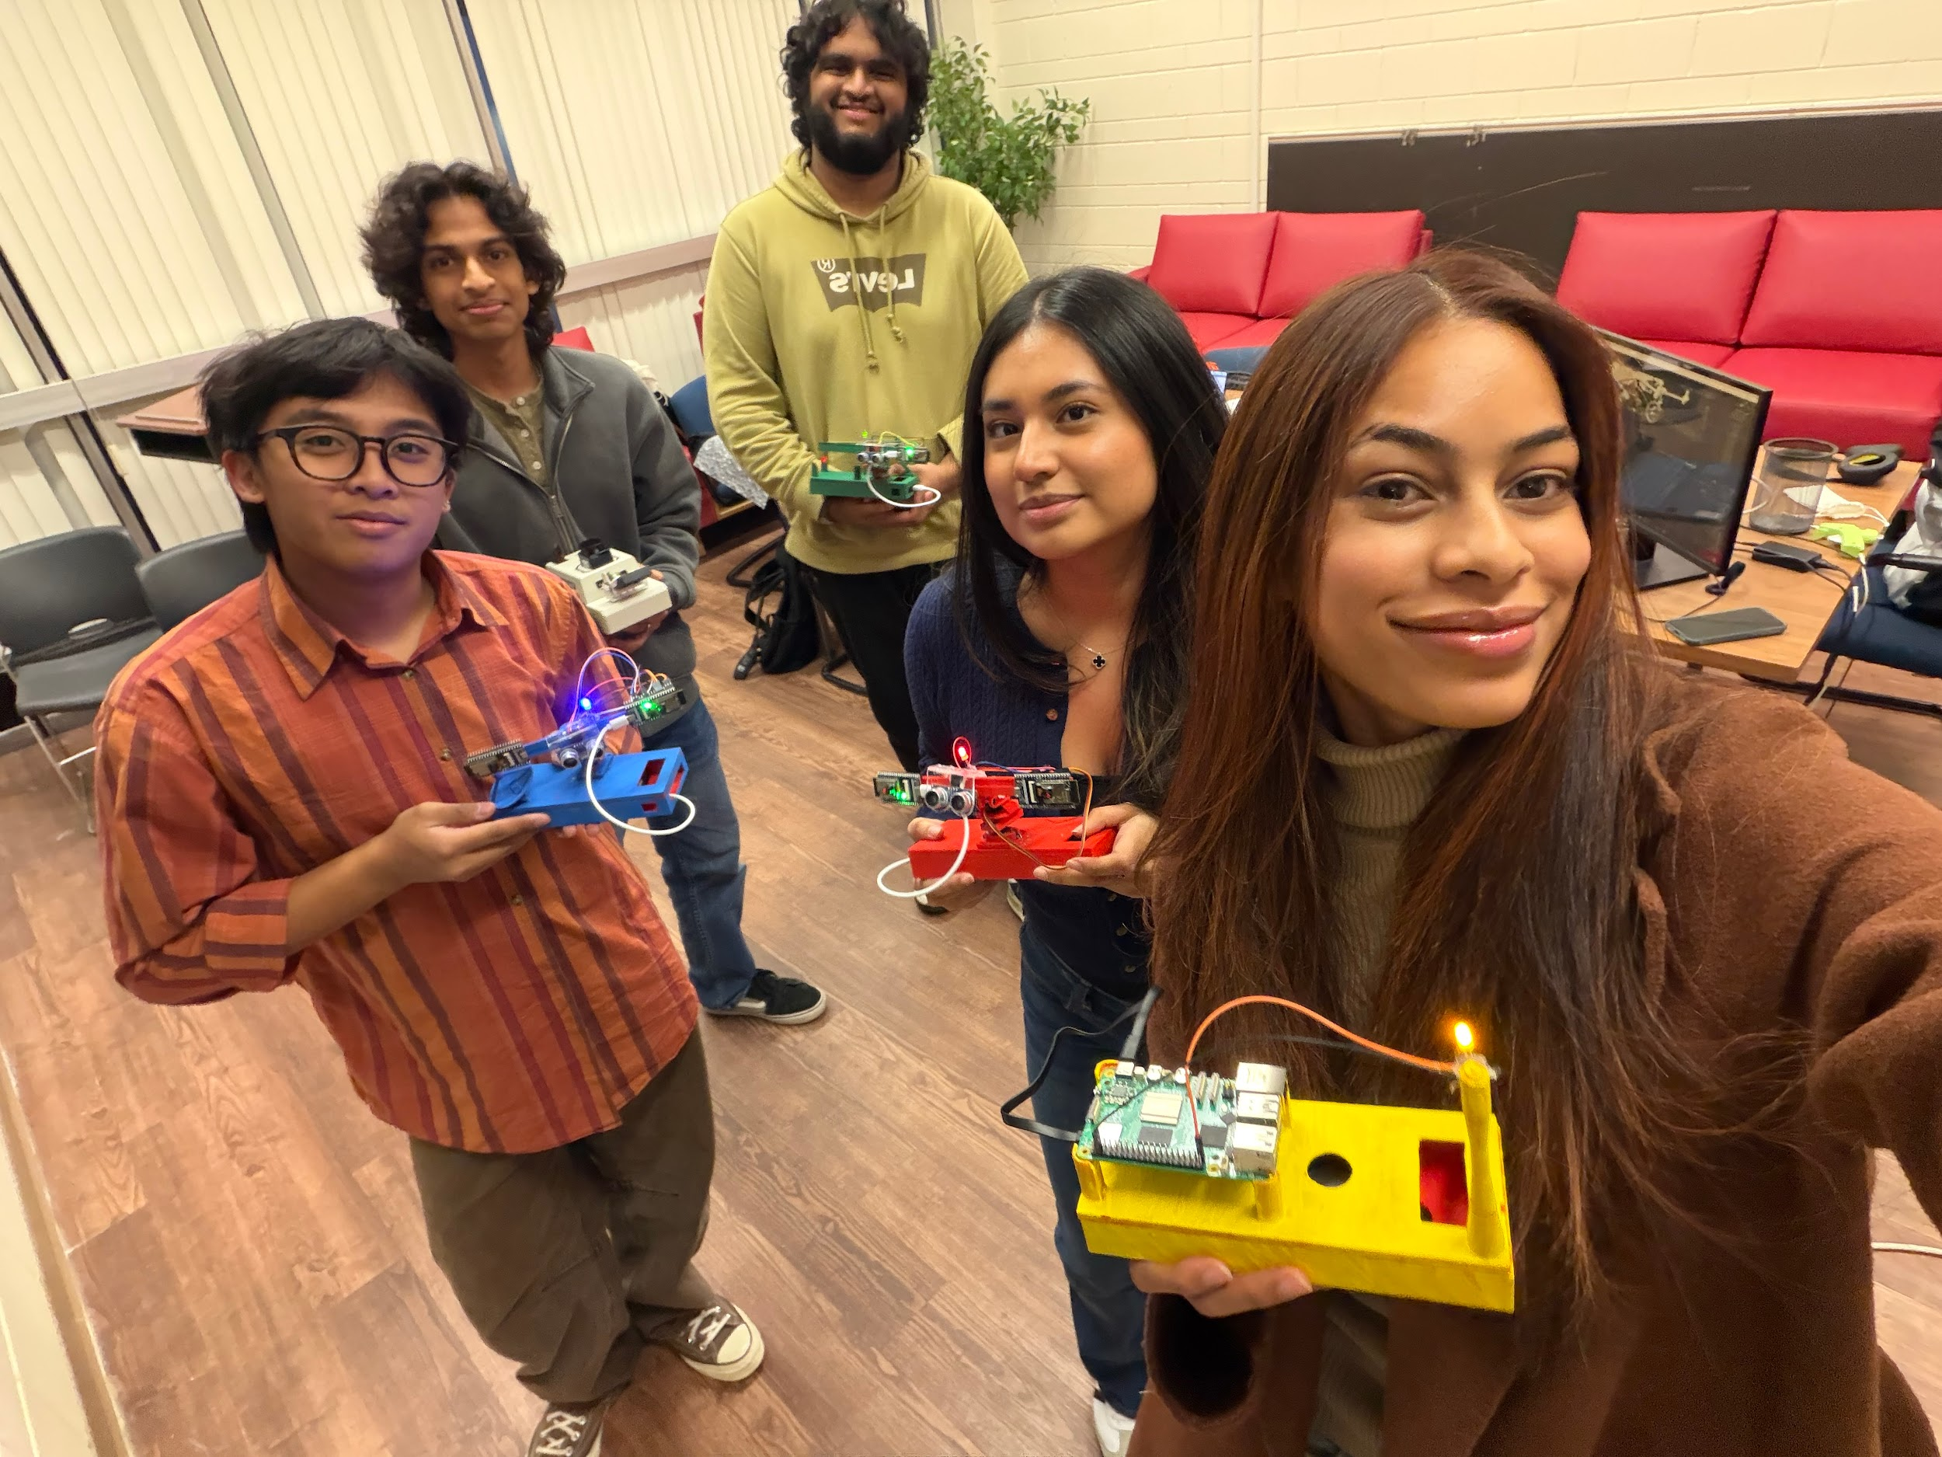
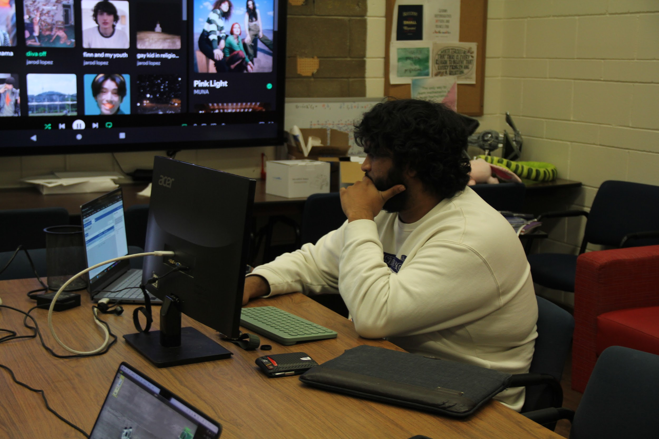
THANK YOU!

